Slide 1
Database Development & Design
Logical Design (data model mapping)

Slide 2
Outline
Strong Entity Vs. Weak Entity
Logical Model Design
Mapping: Rules and Steps
Logical Design Scenarios

Slide 3
Strong and weak entities
A strong entity has a primary key, meaning that it can be uniquely identified by its attributes alone.
A weak entity is an entity that can't be uniquely identified by its attributes alone. It is existence-dependent on its parent entity. It must use a foreign key in conjunction with its attributes to create a primary key.
We call the relationship type that relates a weak entity type to its owner the identifying relationship
The identifying entity type is also sometimes called the parent entity type or the dominant entity type.
The weak entity type is also sometimes called the child entity type or the subordinate entity type.
A weak entity type normally has a partial key, which is the attribute that can uniquely identify weak entities that are related to the same owner entity.
The partial key is sometimes called the discriminator

Slide 4
Logical Model
A logical data model describes the data in as much detail as possible, without regard to how they will be physical implemented in the database. Logical model include:
  All entities and relationships among them.
  All attributes for each entity are specified.
  The primary and foreign keys for each entity is specified.
  Resolves relationships.
  Create normalized business rules.

Slide 5
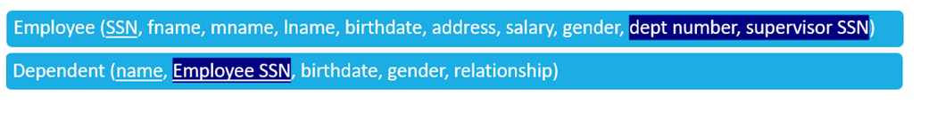
Strong and weak entities
Employee is a strong entity because it has a primary key attribute (SSN) which is capable of uniquely identifying all the employee.
Unlike Employee, Dependents is weak entity.

Slide 6
Database Schema
A schema for a database is an outline of how data is organized. It can be a graphic illustration, or another kind of chart used by programmers to understand how each table is laid out, including the columns and the types of data they hold and how tables connect.
A database schema usually specifies which columns are primary keys in tables and which other columns have special constraints such as being required to have unique values in each record.
It also usually specifies which columns in which tables contain references to data in other tables, often by including primary keys from other table records so that rows can be easily joined (foreign key columns).

Slide 7

Mapping Steps

Slide 8
Mapping
Mapping: is the procedures to create a relational schema from an entity–relationship (ER).
Rules of Mapping:
  Every entity is a table.
  Every attribute is represented as a column.
  Any derived attribute should not be mapped because we can calculate it from another attribute.
  Any multi-valued attribute should be extracted to new table.
  Any composite attribute should be separated so that every attribute has its individual column.
  In 1:1 relation and 1:M relation, we should make a link between tables by adding reference from the PK to FK.
  Any many to many (M:N) relation will be represented as new table. And the primary key of this table will be a combination of the primary keys of the two ends of the relation.

Slide 9
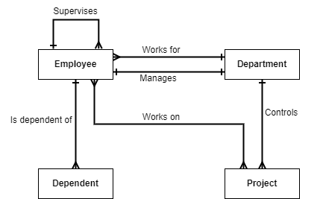
Company Example
Scenario:
The company is organized into departments. Each department has an employee who manages the department. Each department controls a number of projects. Each employee works for one department but may work on several projects. Each employee may have a number of dependents.
Conceptual Model

Slide 10
Company Example - Details
Scenario:
The company is organized into DEPARTMENTs. Each department has a name, number and an employee who manages the department. We keep track of the start date of the department manager. A department may have several locations. Each department controls a number of PROJECTs. Each project has a unique name, unique number and is located at a single location. Each EMPLOYEE has a social security number, salary, gender, and birthdate. Each employee works for one department but may work on several projects. We keep track of the number of hours per week that an employee currently works on each project. It is required to keep track of the direct supervisor of each employee. Each employee may have a number of DEPENDENTs. For each dependent, we keep a record of name, sex, birthdate, and relationship to the employee.

Slide 11
Mapping Steps
Step 1: Mapping of Regular (Strong) Entity Types
Step 2: Mapping of Weak Entity Types
Step 3: Remove Derived attributes
Step 4: Mapping of Multivalued Attributes.
Step 5: Mapping of Composite Attributes.
Step 6: Mapping of 1:1 Relationship Types.
Step 7: Mapping of 1:N Relationship Types.
Step 8: Mapping of M:N Relationship Types.

Slide 12
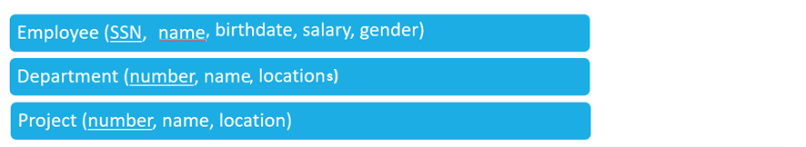
Database Schema –With Strong Entities Only

Slide 13
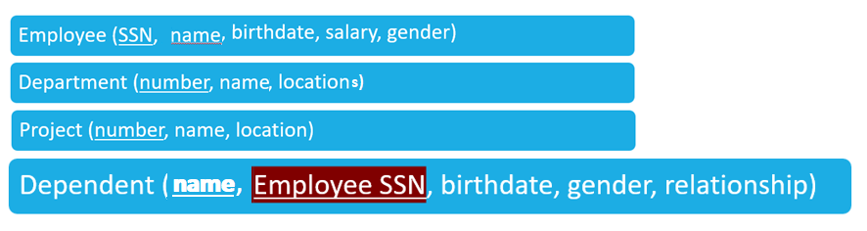
Database Schema –With Weak Entities

Slide 14
Mapping – Multi-value
number | name | locations
1 | HeadQuarters | Houston
4 | Administration | Stafford
5 | Research | {Bellaire, Houston, Sugarland}
Department - Before Mapping:
Department - After Mapping
Department-Location - After Mapping
number | name
1 | HeadQuarters
4 | Administration
5 | Research
dept_number | location
5 | Bellaire
1 | Houston
5 | Houston
4 | Stafford
5 | Sugarland

Slide 15
Mapping - Composite
Employee - Before Mapping:
SSN | name | birthdate | gender | salary
123456789 | John B Smith | 1/9/1965 | M | 30000
Employee - After Mapping:
SSN | fname | mname | lname | birthdate | gender | salary
123456789 | John | B | Smith | 1/9/1965 | M | 30000

Slide 16
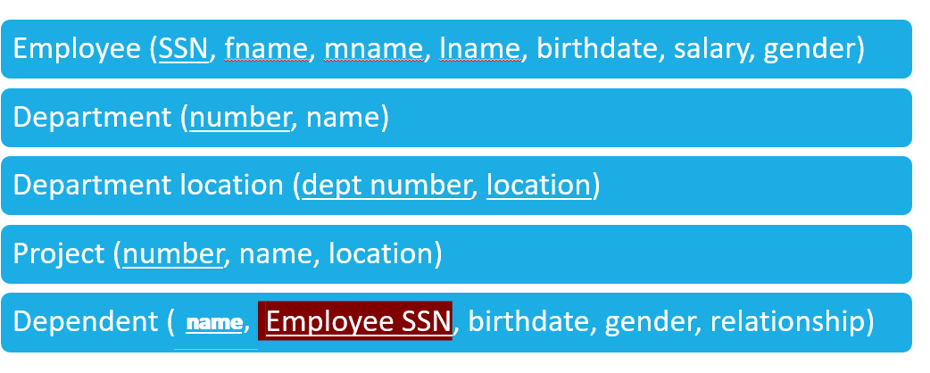
Database Schema

Slide 17
Mapping – 1:1 Relations
Relation between Employee and Department (Mange Relationship)
Department - Before Mapping
Department (number, name)
Mapping:
Include the primary key SSN of the Employee relation as a foreign key attribute of Department (renamed to manager SSN).
Attribute start date in department represents the start date attribute of the relationship type.
Department - After Mapping
Department (number, name, start date, manager SSN)

Slide 18
Mapping – 1:M Relations
Examples:
  For works for, we include the primary key number of the Department relation as foreign key in the Employee relation and call it dept number.
  For controls, we include the primary key number of the Department relation as foreign key in the Project relation and call it dept number.
  For supervises, we include the primary key SSN of the Employee relation as foreign key in the Employee relation and call it supervisor SSn.
Employee (SSN, fname, mname, lname, birthdate, salary, gender, dept number, supervisor SSN)
Department (number, name, start date, manager SSN)
Project (number, name, location, dept number)
Dependent (name, Employee SSN, birthdate, gender, relationship)
Depart loc (dept number, location)

Slide 19
Mapping – M:N Relations
Example: The M:N relationship type works on is mapped by creating a relation Employee Project.
The primary keys of the Project and Employee relations are included as foreign keys in Employee Project and renamed proj number and emp SSN, respectively.
Attribute hours in Employee Project represents the hours attribute of the relationship type. The primary key of the Employee Project relation is the combination of the foreign key attributes {proj number, emp SSN}.
Employee Project (Emp SSN, Proj number, hours)

Slide 20
Finally - Database Schema
Employee (SSN, fname, mname, lname, birthdate, salary, gender, dept number, supervisor SSN)
Department (number, name, start date, manager SSN)
Depart loc (dept number, location)
Project (number, name, location, dept number)
Dependent (name, Employee SSN, birthdate, gender, relationship)
Employee Project (Emp SSN, Proj number, hours)
Note: Primary keys are underlined, and foreign keys are highlighted in dark blue

Slide 21
Finally - Database Schema
Employee (SSN, fname, mname, lname, birthdate, salary, gender, dept number, supervisor SSN)
Department (number, name, start date, manager SSN)
Depart loc (dept number, location)
Project (number, name, location, dept number)
Dependent (name, Employee SSN, birthdate, gender, relationship)
Employee Project (Emp SSN, Proj number, hours)
Note: Primary keys are underlined, and foreign keys are highlighted in dark blue

Slide 22
Database Scenario – with Crow’s Foot Notations

Slide 23
Bank Management System Example
Scenario:
The bank has many branches. Each branch consists of multiple departments, and each department includes many employees. The employee should work in one department. An employee can make many transactions. Each transaction is performed on one account. Note: the account may have multiple transactions. In addition, the account is owned by one or more customers and customers can have multiple accounts. There are many account types like (saving, checking, and money market accounts). For each account, there is one account type. Customers can visit multiple branches.

Slide 24
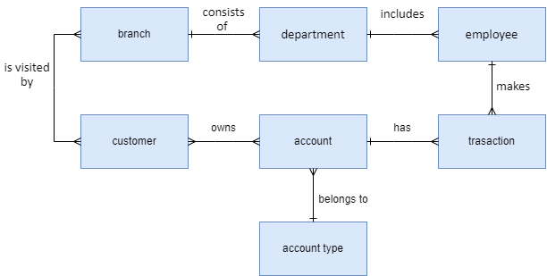
Conceptual Model

Slide 25
Bank Management System Example
Scenario:
The bank has many branches. Each branch has a number, name, phone, and Address. Each branch consists of multiple departments. Each department has a name and phone and includes many employees. Each employee has an id, name, password, email, salary, level, and address. The employee should work in one department. An employee can make many transactions. Each transaction has an id, type, date, time, and channel. Each transaction is performed on one account. Each account has a type, number, status, and balance. Note: the account may have multiple transactions. In addition, the account is owned by one or more customers and customers can have multiple accounts. Each customer has an id, name, SSN, date of birth, email, and can have multiple addresses and multiple phones. There are many account types like (saving, checking, and money market accounts). Each account type has an id, name and description. For each account, there is one account type. Customers can visit multiple branches. Each visit is recorded with date and time.

Slide 26
Basic Step (Strong and Weak Entities)
    Branch (number, name, phone, address)
    Department (name, branch_number, phone)
    Employee (id, name, password, email, salary, level, address)
    Transaction (id, type, date, time, channel)
    Customer (id, name, SSN, date of birth, email, phones, addresses)
    Account (number, status, balance, type)
    Account type (id, name, description)
Remember the Rule:
Every entity is a table.
Every attribute is represented as a column, and determine PKs.

Slide 27
Derived Attributes Step
    Branch (number, name, phone, address)
    Department (name, branch_number, phone)
    Employee (id, name, password, email, salary, level, address)
    Transaction (id, type, date, time, channel)
    Customer (id, name, SSN, date of birth, email, phones, addresses)
    Account (number, status, balance, type)
    Account type (id, name, description)
Remember the rule:
Any derived attribute should not be mapped because we can calculate it from another attribute.
No Derived attributes → so no change!

Slide 28
Multi-valued Attributes Step
    Branch (number, name, phone, address)
    Department (name, branch_number, phone)
    Employee (id, name, password, email, salary, level, address)
    Transaction (id, type, date, time, channel)
    Customer (id, name, SSN, date of birth, email, phones, addresses)
    Account (number, status, balance, type)
    Account type (id, name, description)
Remember the Rule: Any multi-valued attribute should be extracted to new table

Slide 29
Multi-valued Attributes Step
    Branch (number, name, phone, address)
    Department (name, branch_number, phone)
    Employee (id, name, password, email, salary, level, address)
    Transaction (id, type, date, time, channel)
    Customer (id, name, SSN, date of birth, email)
    Customer_addresses (customer_id, address)
    Customer_phones (customer_id, phone)
    Account (number, status, balance, type)
    Account type (id, name, description)

Slide 30
Composite attributes Step
    Branch (number, name, phone, address)
    Department (name, branch_number, phone)
    Employee (id, name, password, email, salary, level, address)
    Transaction (id, type, date, time, channel)
    Customer (id, name, SSN, date of birth, email)
    Customer_addresses (customer_id, address)
    Customer_phones (customer_id, phone)
    Account (number, status, balance, type)
    Account type (id, name, description)
Remember the Rule:
Any composite attribute should be separated so that every attribute has its individual column.

Slide 31
Composite Attributes Step CONT …
    Branch (number, name, phone, country, city, street name, building number)
    Department (name, branch_number, phone)
    Employee (id, fname, lname, password, email, salary, level, country, city, street name, building number)
    Transaction (id, type, date, time, channel)
    Customer (id, fname, lname, SSN, date of birth, email)
    Customer_addresses (customer_id, country, city, street name, building number)
    Customer_phones (customer_id, phone)
    Account (number, status, balance, type)
    Account type (id, name, description)

Slide 32
Relations (1:1) and (1:M)
Branch : Department → 1:M (consists of )
Department : Employee → 1:M (includes)
Employee : Transaction → 1:M (make)
Account: Transaction → 1:M (has)
Account Type: Account → 1:M (has)
Remember the Rule:
In 1:1 relation and 1:M relation, we should make a link between tables by adding reference from the PK to FK.

Slide 33
Relations (1:1) and (1:M)
    Branch (number, name, phone, country, city, street name, building number)
    Department (name, branch_number , phone)
    Employee (id, fname, lname, password, email, salary, level, country, city, street name, building number, department_name, branch_number)
    Transaction (id, type, date, time, channel, employee_id, account_number)
    Customer (id, fname, lname, SSN, date of birth, email)
    Customer_addresses (customer_id,country, city, street name, building number)
    Customer_phones (customer_id, phone)
    Account (number, status, balance, type_id)
    Account type (id, name, description)

Slide 34
Relations (M:N)
Customer : Account → M:N (own)
Customer : Branch → M:N (visit)
Remember the Rule:
Any many to many (M:N) relation will be represented as new table. And the primary key of this table will be a combination of the primary keys of the two ends of the relation

Slide 35
Relations (M:N)
    Branch (number, name, phone, country, city, street name, building number)
    Department (name, branch_number, phone)
    Employee (id, fname, lname, password, email, salary, level, country, city, street name, building number, department_name, branch_number)
    Transaction (id, type, date, time, channel, employee_id, account_number)
    Customer (id, fname, lname, SSN, date of birth, email)
    Customer_addresses (customer_id,country, city, street name, building number)
    Customer_phones (customer_id, phone)
    Account (number, status, balance, type_id)
    Account type (id, name, description)
    Ownership (customer_id, account_number)
    Visit (customer_id, branch_number, date, time)

Slide 36
Final Schema!
    Branch (number, name, phone, country, city, street name, building number)
    Department (name, branch_number, phone)
    Employee (id, fname, lname, password, email, salary, level, country, city, street name, building number, department_name, branch_number)
    Transaction (id, type, date, time, channel, employee_id, account_number)
    Customer (id, fname, lname, SSN, date of birth, email)
    Customer_addresses (customer_id,country, city, street name, building number)
    Customer_phones (customer_id, phone)
    Account (number, status, balance, type_id)
    Account type (id, name, description)
    Ownership (customer_id, account_number)
    Visit (customer_id, branch_number, date, time)
Note: Primary keys are underlined, and foreign keys are colored with red

Slide 37
Strong and Weak Entities
    Branch (number, name, phone, country, city, street name, building number)
    Department (name, branch_number, phone)
    Employee (id, fname, lname, password, email, salary, level, country, city, street name, building number, department_name, branch_number)
    Transaction (id, type, date, time, channel, employee_id, account_number)
    Customer (id, fname, lname, SSN, date of birth, email)
    Customer_addresses (customer_id,country, city, street name, building number)
    Customer_phones (customer_id, phone)
    Account (number, status, balance, type_id)
    Account type (id, name, description)
    Ownership (customer_id, account_number)
    Visit (customer_id, branch_number, date, time)
Strong Entities
Weak Entities

Slide 38
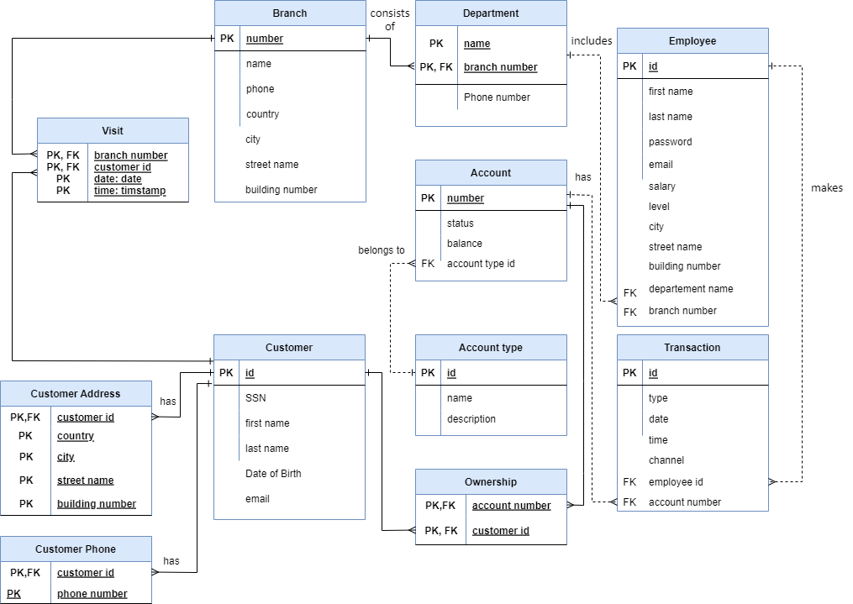
Logical Model

Slide 39
References
Elmasri, R., & Navathe, S. (2017). Fundamentals of database systems (Vol. 7). Pearson
Eng. Lina’s slides
Dr. Raneem’s slides.

